Slide 1




Blockchain based electricity market system
Basic backend implementation
Yuxie Zhou 116010328
2020/12/7

Slide 2


1
Introduction
01
Blockchain can be defined as a distributed ledger technology that can record transactions between parties in a secure and permanent manner.
02
Using the solidity programming language we are developing a Electricity Market Application.
03
A Electricity market consists of many producers, providers, consumers and their transactions of energy and respective funds. I have made an application which keeps a track of these transactions.
03

Slide 3
2
Objective
To develop Decentralized Autonomous System for an Electricity Market
To develop a Supply Chain for Energy and Funds Transfer.
Increasing the trust between various participants and bringing transparency in the supply chain.
Flow of money should be secure and it should use any type of Digital Currency.
Using BlockChain technology in Smart Grid application can achieve cost savings by more automated, error-free and less paper work processes.
To manage the ownership of digital assets and facilitate asset transfers.

Slide 4
3
Why need blockchain
BLOCK CHAIN TECHNOLOGY IS –
Transparent and Tractable.
Secure and Authorized Transactions and digital ledgers.
Creates trust among several individuals and entities.
Keeps the track and information about product to every stake holder.
Less paperwork.
Decentralized system.

Slide 5
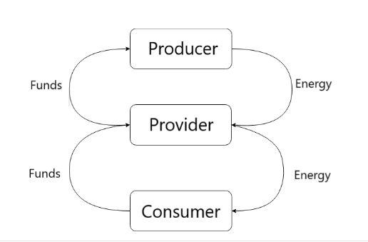
4
Simple Model Layout

Slide 6
5
Proposed System
What we are proposing –
A Decentralized autonomous system for tracking the fund and energy transfer between different entities .
Multiple entities with different databases.
Permission rights and authentication for every entities are defined.
All entities work on a global platform
Whole process is governed by smart contracts.
Payments through the cryptocurrencies can be done.
Automatically change of ownership of product from one entity to another.

Slide 7
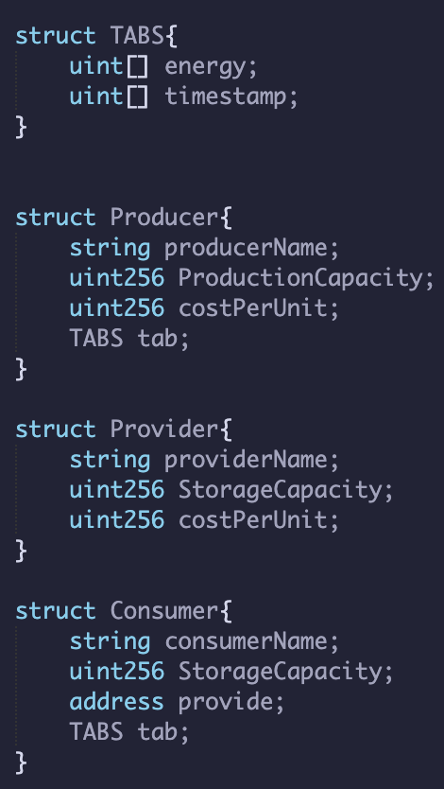
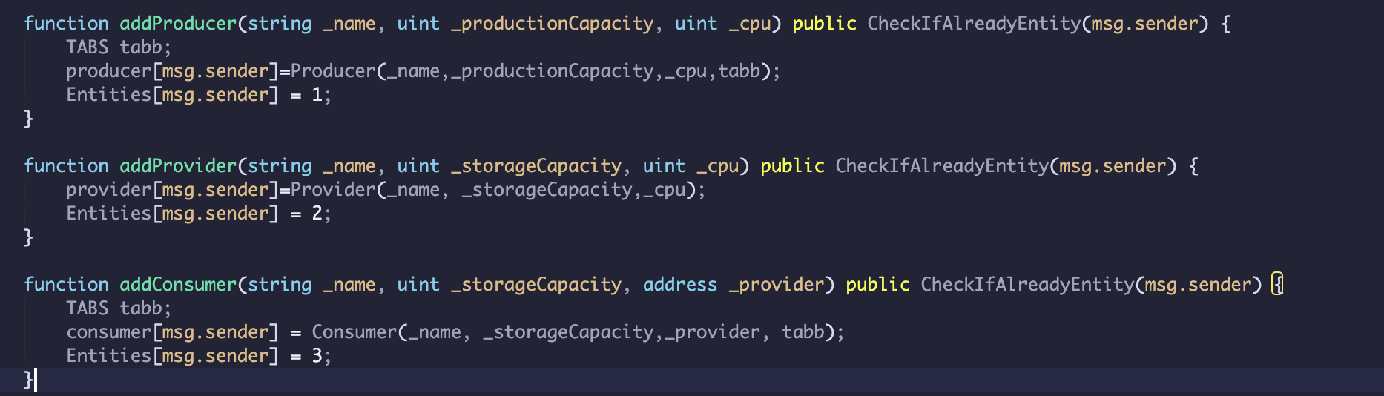
6-1
Functionality of Users
Producer
Has a unique Cost Per Unit.
Has a maximum production capacity.
Has an account to keep a tab on the funds remaining.
Every time energy is transferred, it is written on the BlockChain.
Has the sole right to produce Energy.
Has a tab for every time energy is produced.
Provider
Has a unique Cost Per Unit.
Has a maximum storage capacity.
Has an account to keep a tab on the funds remaining.
Every time energy is transferred, it is written on the BlockChain.
Consumer
Has the sole right to consume energy.
Has a maximum storage capacity.
Has an account to keep a tab on the funds remaining.
Every time energy is transferred, it is written on the BlockChain.
Has a tab for every time energy is consumed.
If Consumer runs out of energy, energy is automatically transferred from the Provider to the Consumer at a hiked price.

Slide 8
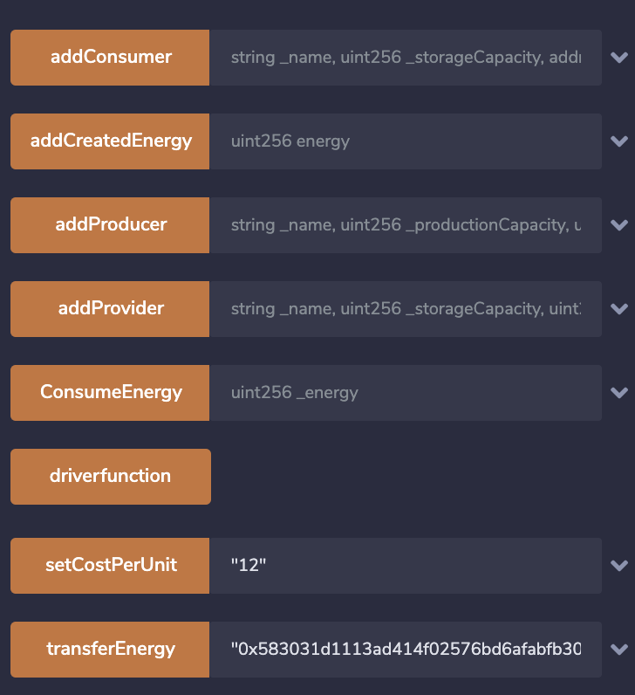
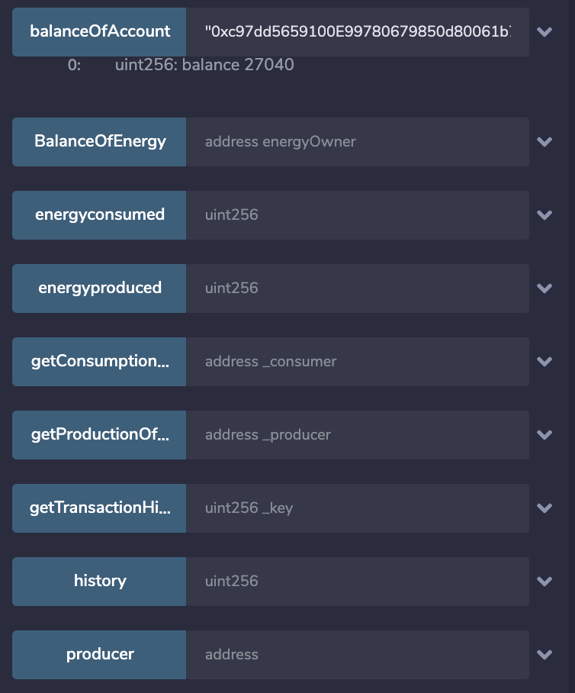
6-2
Available Functions

Slide 9
7
Technology Used
Solidity programming:
-Used to design and code various contracts .
-IDE used: Remix
Digital payment transfer.

Slide 10
8
Conclusion
I have designed a basic working model of A Blockchain-based Application for an electricity market system.

Slide 11
10
Reference
Mengelkamp, E., Notheisen, B., Beer, C. et al. A blockchain-based smart grid: towards sustainable local energy markets. Comput Sci Res Dev 33, 207–214 (2018). https://doi.org/10.1007/s00450-017-0360-9.
S Cheng, B Zeng, Y Z Huang, Research on application model of blockchain technology in distributed electricity market. https://iopscience.iop.org/article/10.1088/1755-1315/93/1/012065/meta.
https://medium.com/@robbertvermeulen/learn-solidity-the-ethereum---smart-contract-programming-language-7f106fc26d6
https://blockgeeks.com/guides/solidity/
http://solidity.readthedocs.io/en/v0.4.24/units-and-global-variables.html

Slide 12
11
Future Enhancement
Add a GUI.
Add more sophisticated and efficient programming.
Add a periodic function to simulate the scenario instead of manually typing everything in.

Slide 13
Thank you..
Any Questions?

